Slide 1
ERO Working Group
Continuing Medical Education in Dentistry
ERO Plenary Session 2021

Slide 2
ERO WG Continuing Medical Education in Dentistry 2020-2021 Working Plan
Notes:
Proceeding the action plan regarding the WG focus, within the approval of the ERO Board, a new Project constituting a frame program is currently being prepared as a draft for getting finalised and presented.
As it was mentioned in ERO Report in Poznan, to realise and activate that ERO pointing out the vitality of the continuing medical education in dentistry for the advocacy of global health we have in- duced the activities towards to raise the awareness of dental pro- fession on the relationship between oral health and general health; improve collaboration and synergies between different health pro- fessionals. To enhance the extended role the current project is a proposal of lecture topic template about oral and general health re- lated medical topics for the ERO countries.These topics were already discussed and finalised including the most preferred and identified regarding the data obtained from the ERO countries before circulat- ed to NDAs of the member ERO countries for inclusion in their CE ac-
tivities or NDA congresses and may acknowledge as ERO-FDI SESSION. As being the volunteer contributors we believe that the recent de- velopment of the route on continuing education regarding the mul- tidisciplinary approach to maintain oral health as an integral part of general health will assure the awareness as a solid state through ERO’s strength and willing to raise it further.

Slide 3
towards FDI Vision 2030..
The structure of Vision 2030 provides arguments to support the integration of oral health into the wider context of health and sustainability. It is in line with the global public health discourse, hence the need to identify ways to be part of this global movement and dialogue. •
The Vision 2030 Report relies on three main pillars:
o Delivering available, affordable and accessible oral healthcare services
o Integrating oral health in the general health agenda
o Building a resilient oral health workforce for sustainable development

Slide 4
…during this pandemic times to support our CE events hereby we are pleased to recieve any request to support all our ERO Member NDAs with online CE events and call for any possible collaboration to organize interdisciplinary educational activities …
“ERO SESSION”
Notes:
Proceeding the action plan regarding the WG focus, within the approval of the ERO Board, a new Project constituting a frame program is currently being prepared as a draft for getting finalised and presented.
As it was mentioned in ERO Report in Poznan, to realise and activate that ERO pointing out the vitality of the continuing medical education in dentistry for the advocacy of global health we have in- duced the activities towards to raise the awareness of dental pro- fession on the relationship between oral health and general health; improve collaboration and synergies between different health pro- fessionals. To enhance the extended role the current project is a proposal of lecture topic template about oral and general health re- lated medical topics for the ERO countries.These topics were already discussed and finalised including the most preferred and identified regarding the data obtained from the ERO countries before circulat- ed to NDAs of the member ERO countries for inclusion in their CE ac-
tivities or NDA congresses and may acknowledge as ERO-FDI SESSION. As being the volunteer contributors we believe that the recent de- velopment of the route on continuing education regarding the mul- tidisciplinary approach to maintain oral health as an integral part of general health will assure the awareness as a solid state through ERO’s strength and willing to raise it further.

Slide 5
Evaluation of the learning formats for Continuing Medical Education in Dentistry
to highlight the ERO member NDA dentists’ preferred learning format for CME activities which they felt most effective in helping them retain information or change their medical attitude in practice.
On-line survey
Disrubution among FDI-ERO member countries
https://docs.google.com/forms/d/e/1FAIpQLSeFTcrC_aCUJxj6uXXiLMNgL4Rni1t1Nl0qBaDg7Z8nW_HEAg/viewform
n=490

Slide 6
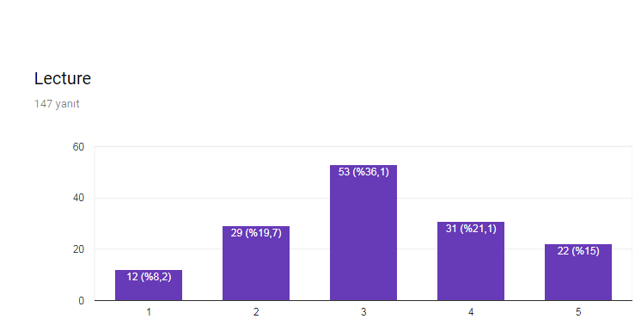
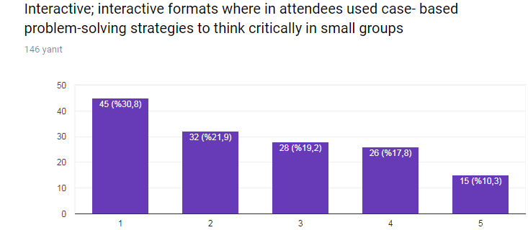
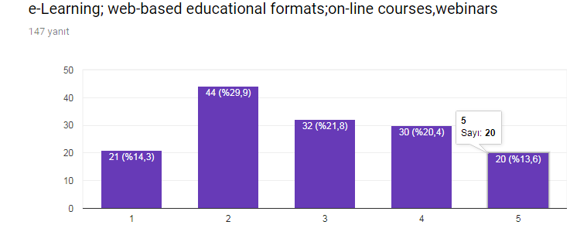
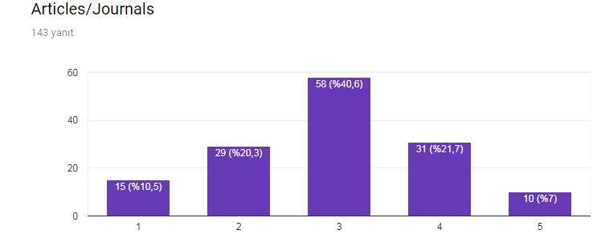
ERO Continuing Medical Education in Dentistry
e-learning
lectures
Interactive
articles
Notes:
Proceeding the action plan regarding the WG focus, within the approval of the ERO Board, a new Project constituting a frame program is currently being prepared as a draft for getting finalised and presented.
As it was mentioned in ERO Report in Poznan, to realise and activate that ERO pointing out the vitality of the continuing medical education in dentistry for the advocacy of global health we have in- duced the activities towards to raise the awareness of dental pro- fession on the relationship between oral health and general health; improve collaboration and synergies between different health pro- fessionals. To enhance the extended role the current project is a proposal of lecture topic template about oral and general health re- lated medical topics for the ERO countries.These topics were already discussed and finalised including the most preferred and identified regarding the data obtained from the ERO countries before circulat- ed to NDAs of the member ERO countries for inclusion in their CE ac-
tivities or NDA congresses and may acknowledge as ERO-FDI SESSION. As being the volunteer contributors we believe that the recent de- velopment of the route on continuing education regarding the mul- tidisciplinary approach to maintain oral health as an integral part of general health will assure the awareness as a solid state through ERO’s strength and willing to raise it further.

Slide 7
Health care professions usually prefer traditional lecture-based format
Retain of the information
Change attitudes and practice behaviors
is not acquisited as required
most effective learning modalities…
still a concern!

Slide 8
2021 Working Plan
to enroll a survey especially regarding students who will be the emerging group in following years with lack of theoretical and practical educational gaps.
to determine what can be impilicated and point-out the absence especially to be compensated through their medical-dental relation based education as well.
These data will be undoubted extremely promising to present within ERO Plenary Session but more would be a strong evidence as a resolution statement.
On-line survey
Disrubution among FDI-ERO member countries

Slide 9
Thank you…
Taner Yücel
Supervisor-Board Member
Hande Sar Sancakli
Chair-WG
Members
Halina BORGIEL-MAREK (Poland)
Ketevan GOGILASHVILI (Georgia)
Maria Gabriella GRUSOVIN (Italy)
Lior KATSAP (Israel)
Enrico LAI (Italy)
Vladimer MARGVELASHVILI (Georgia)
Paulo MELO (Portugal)
Paula PERLEA (Romania)
Joël TROUILLET (France)
Georgios TSIOGAS (Greece)
Thomas Wolf (Germany)
Bedros YAVRU-SAKUK (Armenia)
Working Group-
CONTINUING MEDICAL EDUCATION IN DENTISTRY

